Slide 1
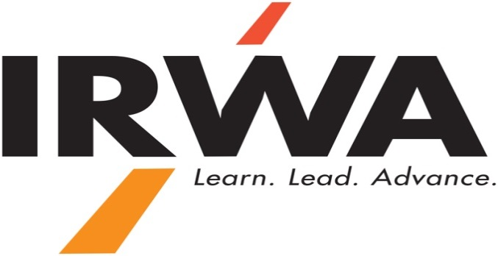
The U.S. Uniform Relocation Assistance and Real Property Acquisition Policies Act of 1970, as amended
Douglas M. Hummel, SR/WA
Land Assembly Coordinator, Department of Transportation, State of Connecticut, USA
Senior Right of Way Agent, International Right of Way Association
Honorary Member Compulsory Purchase Association

Slide 2
The Takings Clause
The last twelve words of the 5th Amendment to the U.S. Constitution state, “……….; nor shall private property be taken for public use, without just compensation.”

Slide 3
The Takings Clause (Continued)
Since Chicago B. & Q. Railroad Co. v. Chicago in 1897, the courts have held that the 14th Amendment to the U.S. Constitution extends the Takings Clause to the States.

Slide 4

The Takings Clause (Continued)
The U.S. Supreme Court has consistently held that the Federal Government and the individual States have the power of eminent domain, but are limited by requiring that “just compensation” be paid for private property taken for “public use”.

Slide 5

The Takings Clause (Continued)
When determining compensation, normally “fair market value” is used. Speculative schemes, in which the owner claims the property was intended to be used, are not considered.

Slide 6

The Takings Clause (Continued)
In United States v. 50 Acres of Land (1984), the U.S. Supreme Court wrote, “The Court has repeatedly held that just compensation normally is measured by “the fair market value of the property at the time of taking contemporaneously paid in money.”

Slide 7
The Uniform Act
The Uniform Relocation Assistance and Real Property Acquisition Policies Act of 1970, as amended (UA), is intended to codify how just compensation, in the form of “fair market value” and “relocation assistance”, are determined and distributed for Federally-funded projects.

Slide 8

The Uniform Act (Continued)
Though the States have statutes and constitutional provisions addressing the Takings Clause, all States have now adopted the UA for all projects regardless of the funding source.

Slide 9

The Uniform Act (Continued)
The concept of the “willing seller/willing buyer” in valuation, negotiation and compensation.

Slide 10

The Uniform Act (Continued)
It is constitutionally and morally incumbent on acquiring authorities to “do no harm” and make property owners “whole”.

Slide 11

The Uniform Act (Continued)
Fair market value and relocation assistance are separate and distinct areas of just compensation.

Slide 12
The Uniform Act (Continued)
Fair market value for land and permanent appurtenances.

Slide 13

The Uniform Act (Continued)
Relocation assistance to owner/occupants and tenants for replacement housing payments, mortgage differential payments, moving costs, business reestablishment payments, down payment assistance, in lieu of payments and other relocation assistance.

Slide 14

The Uniform Act (Continued)
Avoiding the adversarial relationship with owners, tenants and the general public:
      Fair Market Value Offer
      Transparent process with shared information
      Negotiating in good faith
      Full Realization of Relocation Benefits

Slide 15

Sound Expensive?
    81% acquired through closing for original offer
    4% acquired through closing as negotiated settlement
    15% acquired through eminent domain
    A third of those are appealed (5% of total acquisitions)
    Two thirds of those are litigated (3% of total acquisitions)

Slide 16

Only 3 out of every 100 acquisitions are litigated.

Slide 17


Slide 18
Acquisition/Relocation Delivery Times
Partial Acquisitions: 6-9 months
Residential acquisitions with relocation: 12-15 months
Commercial/Industrial acquisitions with relocation: 15-18 months

Slide 19

Advantages of UA Provisions
Fewer adversarial acquisitions
Minimal litigation
Better public relations/perception
Shorter delivery time
Lower cost
Consistency across schemes

Slide 20
Advantage not UA related
Acquiring entities pre-possess eminent domain authority through Federal and State constitutions and statutes.
Focus of public involvement and scheme approval is merits of the project, not execution of the land assembly.

Slide 21
Thank you
Questions and Discussion
Douglas M. Hummel, SR/WA

